Slide 1
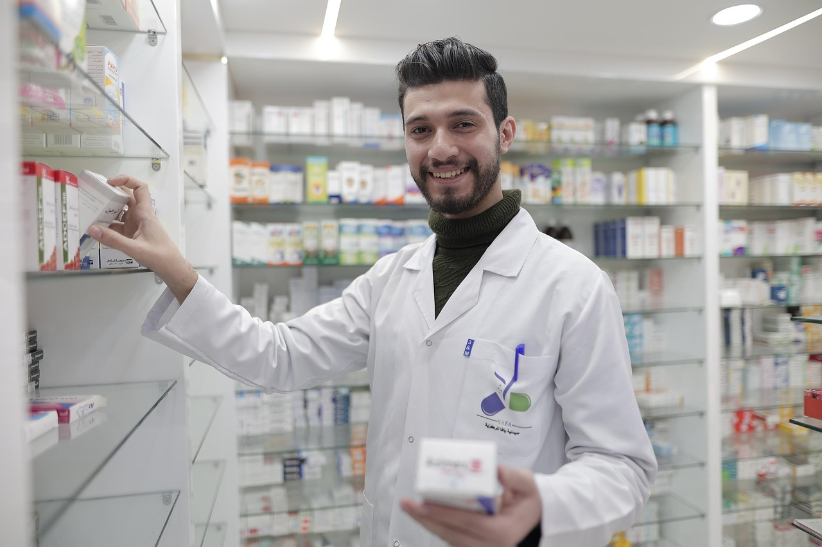


Pharmacy Use
February 2026
S26-048/MB

Slide 2
Methodology
Methodology
Online survey
Questionnaire designed in collaboration with
Dan Pender
Sample
A nationally representative
sample of 1,000 adults 18+ in the Republic of Ireland
Field work dates
26th February – 2nd March 2026
Margin of Error
±3.1% at 95% confidence interval
The margin of error indicates the percentage points the results may differ from the overall population.
Margin of error changes according to the size of sample, the size of the population and to the observed percentage in question.

Slide 3
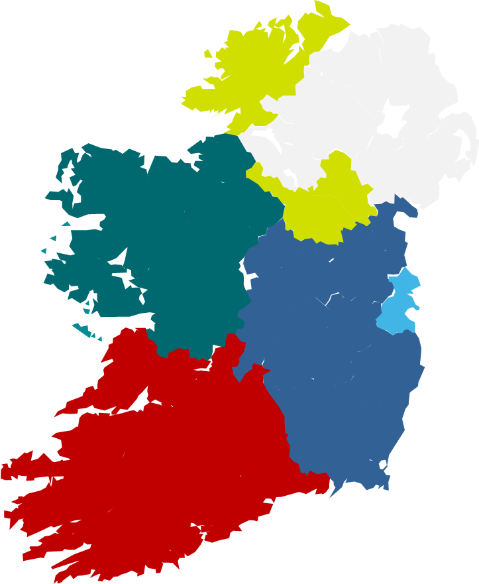
Survey Participant Profile l
(BASE : All respondents -1,000)
Gender
Age
Region
49%
51%
Conn/ Ulster
18%
Rest of
Leinster
26%
Dublin
29%
Social class
Munster
27%

Slide 4
Survey Participant Profile ll
(BASE : All respondents -1,000)
Provide care or support to someone
who has an illness, disability,
mental health condition,
or age-related needs
N=1000
Children living at home
N=1000
Age groups of children
N=484

Slide 5
Section 1:
Medical Costs

Slide 6
43% of Irish adults currently have their medicine costs covered by a Medical Card. This is higher for those aged 55+ and C2DE’s
(Base: All respondents – 1000)
Medical Card
Yes
 | GENDER |  | AGE |  |  |  |  |  | CLASS |  | REGION
 | Male | Female | 18-24 | 25-34 | 35-44 | 45-54 | 55-64 | 65+ | ABC1 F50+ | C2DE F50- | Dublin | Leinster (excl. Dublin) | Munster | Conn/ Ulster
N= | 493 | 506 | 112 | 160 | 202 | 181 | 148 | 197 | 508 | 492 | 289 | 268 | 268 | 175
Yes | 41% | 44% | 40% | 38% | 38% | 36% | 51% | 52% | 32% | 53% | 43% | 43% | 40% | 46%
No | 55% | 53% | 48% | 55% | 58% | 63% | 49% | 47% | 64% | 43% | 52% | 55% | 57% | 50%
Not sure | 4% | 3% | 12% | 7% | 3% | 1% | 1% | 1% | 4% | 3% | 6% | 2% | 3% | 4%
No
Not sure
Q1. Are your medicine costs currently covered by a public payment scheme?

Slide 7
…while one-quarter (25%) are covered by the General Medical Services Scheme (GMS).
(Base: All respondents – 1000)
General Medical Services Scheme (GMS)
Yes
 | GENDER |  | AGE |  |  |  |  |  | CLASS |  | REGION
 | Male | Female | 18-24 | 25-34 | 35-44 | 45-54 | 55-64 | 65+ | ABC1 F50+ | C2DE F50- | Dublin | Leinster (excl. Dublin) | Munster | Conn/ Ulster
N= | 493 | 506 | 112 | 160 | 202 | 181 | 148 | 197 | 508 | 492 | 289 | 268 | 268 | 175
Yes | 24% | 26% | 21% | 22% | 26% | 22% | 21% | 32% | 22% | 28% | 28% | 27% | 18% | 27%
No | 67% | 64% | 57% | 68% | 69% | 75% | 65% | 56% | 71% | 59% | 62% | 66% | 71% | 61%
Not sure | 9% | 10% | 21% | 9% | 5% | 4% | 13% | 12% | 7% | 13% | 10% | 7% | 11% | 12%
No
Not sure
Q1. Are your medicine costs currently covered by a public payment scheme?

Slide 8
3 in 10 (30%) are able to use the Drugs Payment Scheme (DPS) for their medicine costs…
(Base: All respondents – 1000)
Drugs Payment Scheme (DPS)
Yes
 | GENDER |  | AGE |  |  |  |  |  | CLASS |  | REGION
 | Male | Female | 18-24 | 25-34 | 35-44 | 45-54 | 55-64 | 65+ | ABC1 F50+ | C2DE F50- | Dublin | Leinster (excl. Dublin) | Munster | Conn/ Ulster
N= | 493 | 506 | 112 | 160 | 202 | 181 | 148 | 197 | 508 | 492 | 289 | 268 | 268 | 175
Yes | 28% | 32% | 27% | 22% | 29% | 33% | 21% | 44% | 33% | 27% | 31% | 31% | 30% | 26%
No | 62% | 60% | 52% | 71% | 65% | 60% | 69% | 51% | 59% | 64% | 59% | 62% | 62% | 62%
Not sure | 9% | 8% | 20% | 7% | 6% | 7% | 10% | 5% | 8% | 9% | 10% | 6% | 7% | 11%
No
Not sure
Q1. Are your medicine costs currently covered by a public payment scheme?

Slide 9
… while 15% are covered by the Long Term Illness Scheme (LTI).
(Base: All respondents – 1000)
Long Term Illness Scheme (LTI)
Yes
 | GENDER |  | AGE |  |  |  |  |  | CLASS |  | REGION
 | Male | Female | 18-24 | 25-34 | 35-44 | 45-54 | 55-64 | 65+ | ABC1 F50+ | C2DE F50- | Dublin | Leinster (excl. Dublin) | Munster | Conn/ Ulster
N= | 493 | 506 | 112 | 160 | 202 | 181 | 148 | 197 | 508 | 492 | 289 | 268 | 268 | 175
Yes | 16% | 14% | 11% | 13% | 14% | 13% | 26% | 12% | 13% | 17% | 18% | 14% | 14% | 13%
No | 75% | 80% | 69% | 80% | 81% | 83% | 70% | 79% | 82% | 73% | 73% | 80% | 81% | 78%
Not sure | 8% | 6% | 20% | 7% | 4% | 4% | 4% | 9% | 5% | 10% | 9% | 6% | 5% | 8%
No
Not sure
Q1. Are your medicine costs currently covered by a public payment scheme?

Slide 10
Nearly 1 in 4 (23%) currently qualify for free GP visits for their children under 8 years old.
(Base: All respondents – 1000)
Children under
8 yrs old
Yes
 | GENDER |  | AGE |  |  |  |  |  | CLASS |  | REGION
 | Male | Female | 18-24 | 25-34 | 35-44 | 45-54 | 55-64 | 65+ | ABC1 F50+ | C2DE F50- | Dublin | Leinster (excl. Dublin) | Munster | Conn/ Ulster
N= | 493 | 506 | 112 | 160 | 202 | 181 | 148 | 197 | 508 | 492 | 289 | 268 | 268 | 175
Yes | 21% | 25% | 21% | 40% | 43% | 15% | 6% | 9% | 24% | 22% | 24% | 22% | 20% | 27%
No | 72% | 72% | 68% | 52% | 52% | 84% | 91% | 87% | 72% | 72% | 70% | 74% | 76% | 67%
Not sure | 7% | 3% | 10% | 8% | 5% | 1% | 3% | 4% | 4% | 6% | 6% | 4% | 4% | 5%
No
Not sure
Q2. Do you currently qualify for free GP visits?

Slide 11
19% qualify for the over 70s GP visit card.
(Base: All respondents – 1000)
Adults aged
70+
Yes
 | GENDER |  | AGE |  |  |  |  |  | CLASS |  | REGION
 | Male | Female | 18-24 | 25-34 | 35-44 | 45-54 | 55-64 | 65+ | ABC1 F50+ | C2DE F50- | Dublin | Leinster (excl. Dublin) | Munster | Conn/ Ulster
N= | 493 | 506 | 112 | 160 | 202 | 181 | 148 | 197 | 508 | 492 | 289 | 268 | 268 | 175
Yes | 18% | 20% | 11% | 10% | 11% | 11% | 11% | 54% | 15% | 24% | 19% | 19% | 21% | 19%
No | 76% | 76% | 81% | 81% | 82% | 88% | 85% | 43% | 80% | 71% | 73% | 78% | 76% | 75%
Not sure | 6% | 4% | 8% | 9% | 6% | 2% | 4% | 2% | 5% | 5% | 8% | 3% | 3% | 6%
No
Not sure
Q2. Do you currently qualify for free GP visits?

Slide 12
One-quarter are able to visit their GP for free due to income means testing (25%)…
(Base: All respondents – 1000)
Income qualified individuals
Yes
 | GENDER |  | AGE |  |  |  |  |  | CLASS |  | REGION
 | Male | Female | 18-24 | 25-34 | 35-44 | 45-54 | 55-64 | 65+ | ABC1 F50+ | C2DE F50- | Dublin | Leinster (excl. Dublin) | Munster | Conn/ Ulster
N= | 493 | 506 | 112 | 160 | 202 | 181 | 148 | 197 | 508 | 492 | 289 | 268 | 268 | 175
Yes | 20% | 29% | 29% | 26% | 23% | 22% | 26% | 25% | 20% | 29% | 25% | 24% | 24% | 27%
No | 67% | 65% | 56% | 63% | 68% | 70% | 67% | 68% | 72% | 60% | 64% | 68% | 68% | 64%
Not sure | 12% | 6% | 14% | 11% | 9% | 8% | 7% | 7% | 8% | 10% | 11% | 8% | 9% | 10%
No
Not sure
Q2. Do you currently qualify for free GP visits?

Slide 13
… and due to having certain medical conditions (25%).
(Base: All respondents – 1000)
Due to certain medical conditions
Yes
 | GENDER |  | AGE |  |  |  |  |  | CLASS |  | REGION
 | Male | Female | 18-24 | 25-34 | 35-44 | 45-54 | 55-64 | 65+ | ABC1 F50+ | C2DE F50- | Dublin | Leinster (excl. Dublin) | Munster | Conn/ Ulster
N= | 493 | 506 | 112 | 160 | 202 | 181 | 148 | 197 | 508 | 492 | 289 | 268 | 268 | 175
Yes | 24% | 25% | 24% | 27% | 23% | 25% | 24% | 25% | 20% | 30% | 28% | 24% | 21% | 26%
No | 69% | 68% | 66% | 62% | 73% | 70% | 68% | 71% | 74% | 64% | 64% | 71% | 74% | 67%
Not sure | 7% | 6% | 10% | 11% | 4% | 5% | 8% | 3% | 7% | 6% | 8% | 5% | 6% | 7%
No
Not sure
Q2. Do you currently qualify for free GP visits?

Slide 14
Section 2:
Over-the-counter Medicines

Slide 15
The majority of respondents (89%) report price to be an important factor when purchasing over-the-counter (OTC), non-prescription medicines.
(BASE : All respondents -1000)
 | GENDER |  | AGE |  |  |  |  |  | REGION |  |  |  | PUBLIC PAYMENT SCHEME
 | Male | Female | 18-24 | 25-34 | 35-44 | 45-54 | 55-64 | 65+ | Dublin | Leinster (excl. Dublin) | Munster | Conn/ Ulster | Medical card | GMS | DRS | LTI
N= | 493 | 506 | 112 | 160 | 202 | 181 | 148 | 197 | 289 | 268 | 268 | 175 | 425 | 246 | 303 | 149
Very important | 41% | 52% | 28% | 41% | 55% | 52% | 57% | 40% | 43% | 51% | 49% | 39% | 50% | 53% | 49% | 55%
Important | 45% | 40% | 49% | 51% | 37% | 39% | 29% | 51% | 49% | 37% | 40% | 44% | 39% | 36% | 43% | 35%
Unimportant | 11% | 6% | 19% | 8% | 6% | 5% | 11% | 7% | 6% | 8% | 8% | 15% | 7% | 9% | 6% | 6%
Very unimportant | 2% | 1% | 3% | 1% | 1% | 3% | 1% | 1% | 1% | 3% | 1% | 1% | 2% | 1% | 2% | 3%
N/A | 1% | *% | 1% | 0% | *% | 0% | 1% | 2% | *% | 1% | 1% | 0% | 1% | 1% | 1% | 1%
Summary
Important | 85% | 93% | 77% | 91% | 92% | 92% | 87% | 91% | 92% | 88% | 90% | 84% | 90% | 89% | 92% | 90%
Unimportant | 14% | 7% | 22% | 9% | 8% | 8% | 12% | 8% | 7% | 11% | 9% | 16% | 9% | 10% | 8% | 9%
Very important
Important
89%
Important
Unimportant
10%
Unimportant
Very unimportant
N/A
Q3. When purchasing over-the-counter medicines (non-prescription), how important is the price to you?

Slide 16
Of those who buy OTC medicines, buying for ‘myself’ is most common (89%). Around one-third buy for their spouse and kids.
(BASE : Buys over the counter medicines -994)
 | GENDER |  | AGE |  |  |  |  |  | REGION |  |  |  | PUBLIC PAYMENT SCHEME
 | Male | Female | 18-24 | 25-34 | 35-44 | 45-54 | 55-64 | 65+ | Dublin | Leinster (excl. Dublin) | Munster | Conn/ Ulster | Medical card | GMS | DRS | LTI
N= | 488 | 505 | 111 | 160 | 201 | 181 | 147 | 194 | 288 | 265 | 266 | 175 | 421 | 243 | 300 | 148
Myself | 86% | 92% | 82% | 81% | 87% | 88% | 96% | 97% | 88% | 89% | 90% | 89% | 88% | 87% | 90% | 85%
Spouse | 41% | 35% | 9% | 37% | 41% | 48% | 44% | 37% | 35% | 38% | 39% | 40% | 34% | 41% | 42% | 44%
Kids | 29% | 35% | 16% | 39% | 53% | 50% | 22% | 5% | 31% | 34% | 32% | 31% | 32% | 35% | 30% | 30%
Parents | 14% | 11% | 28% | 19% | 14% | 15% | 7% | 0% | 16% | 12% | 12% | 9% | 15% | 15% | 17% | 17%
Other | 2% | 2% | 4% | 2% | *% | 0% | 3% | 3% | 2% | 3% | 2% | 1% | 2% | 1% | 1% | 2%
Q4 Who do you buy over the counter medicines for?

Slide 17
Vast majority (91%) buy their OTC medicines from their local pharmacy.
(BASE : Buys over the counter medicines -994)
 | GENDER |  | AGE |  |  |  |  |  | REGION |  |  |  | PUBLIC PAYMENT SCHEME
 | Male | Female | 18-24 | 25-34 | 35-44 | 45-54 | 55-64 | 65+ | Dublin | Leinster (excl. Dublin) | Munster | Conn/ Ulster | Medical card | GMS | DRS | LTI
N= | 488 | 505 | 111 | 160 | 201 | 181 | 147 | 194 | 288 | 265 | 266 | 175 | 421 | 243 | 300 | 148
A local pharmacy | 89% | 92% | 89% | 89% | 90% | 97% | 89% | 88% | 89% | 91% | 93% | 89% | 91% | 89% | 89% | 93%
A supermarket | 28% | 30% | 26% | 25% | 26% | 23% | 35% | 39% | 28% | 30% | 30% | 28% | 25% | 25% | 30% | 21%
Online | 7% | 4% | 4% | 12% | 6% | 6% | 4% | 2% | 7% | 5% | 4% | 5% | 5% | 6% | 7% | 6%
I don't usually buy over-the-counter medicines | *% | *% | 0% | 0% | 0% | 0% | 1% | 1% | *% | 1% | 0% | 0% | *% | 1% | 1% | 1%
Q5A. Where do you usually buy over the counter (non-prescription) medicines like pain relief, cold/flu remedies, skin treatment or allergy tablets?

Slide 18
However, only two-thirds (67%) always go to the same pharmacy when buying OTC medicines.
(BASE : Buys over the counter medicines -991)
 | GENDER |  | AGE |  |  |  |  |  | REGION |  |  |  | PUBLIC PAYMENT SCHEME
 | Male | Female | 18-24 | 25-34 | 35-44 | 45-54 | 55-64 | 65+ | Dublin | Leinster (excl. Dublin) | Munster | Conn/ Ulster | Medical card | GMS | DRS | LTI
N= | 486 | 504 | 111 | 160 | 201 | 181 | 146 | 192 | 287 | 263 | 266 | 175 | 419 | 241 | 299 | 147
Yes | 71% | 64% | 63% | 67% | 63% | 65% | 73% | 71% | 64% | 66% | 70% | 69% | 74% | 76% | 75% | 85%
No | 29% | 36% | 37% | 33% | 37% | 35% | 27% | 29% | 36% | 34% | 30% | 31% | 26% | 24% | 25% | 15%
Q5B. When buying over the counter (non-prescription) medicines do you always go to the same pharmacy?

Slide 19
For those who do always use the same pharmacy, 61% believe they have a strong relationship with the business.
(Base: Always uses the same pharmacy- 665)
 | GENDER |  | AGE |  |  |  |  |  | REGION |  |  |  | PUBLIC PAYMENT SCHEME
 | Male | Female | 18-24 | 25-34 | 35-44 | 45-54 | 55-64 | 65+ | Dublin | Leinster (excl. Dublin) | Munster | Conn/ Ulster | Medical card | GMS | DRS | LTI
N= | 343 | 322 | 70 | 108 | 126 | 119 | 106 | 137 | 184 | 174 | 186 | 120 | 312 | 183 | 224 | 125
Very strong relationship | 20% | 20% | 4% | 11% | 11% | 20% | 27% | 38% | 16% | 21% | 22% | 20% | 23% | 27% | 29% | 24%
Strong | 44% | 38% | 42% | 34% | 37% | 49% | 40% | 43% | 41% | 37% | 46% | 37% | 48% | 40% | 42% | 45%
Moderate | 31% | 34% | 44% | 36% | 41% | 30% | 33% | 18% | 34% | 38% | 26% | 33% | 23% | 26% | 23% | 21%
Weak | 4% | 6% | 7% | 16% | 8% | 1% | 0% | 1% | 7% | 3% | 5% | 6% | 4% | 5% | 5% | 6%
Very weak relationship | 2% | 2% | 3% | 4% | 2% | 1% | 1% | 1% | 2% | 1% | 1% | 3% | 1% | 2% | 1% | 2%
Summary
Strong relationship | 63% | 58% | 46% | 45% | 48% | 68% | 66% | 81% | 58% | 58% | 68% | 57% | 71% | 67% | 70% | 70%
Weak relationship | 6% | 8% | 10% | 19% | 11% | 2% | 1% | 1% | 9% | 4% | 6% | 9% | 6% | 7% | 6% | 9%
Very Strong relationship
Strong
61%
Strong
Moderate
Weak
Weak
7%
Very weak relationship
Q5c How strong is the relationship with the pharmacy you always use?

Slide 20
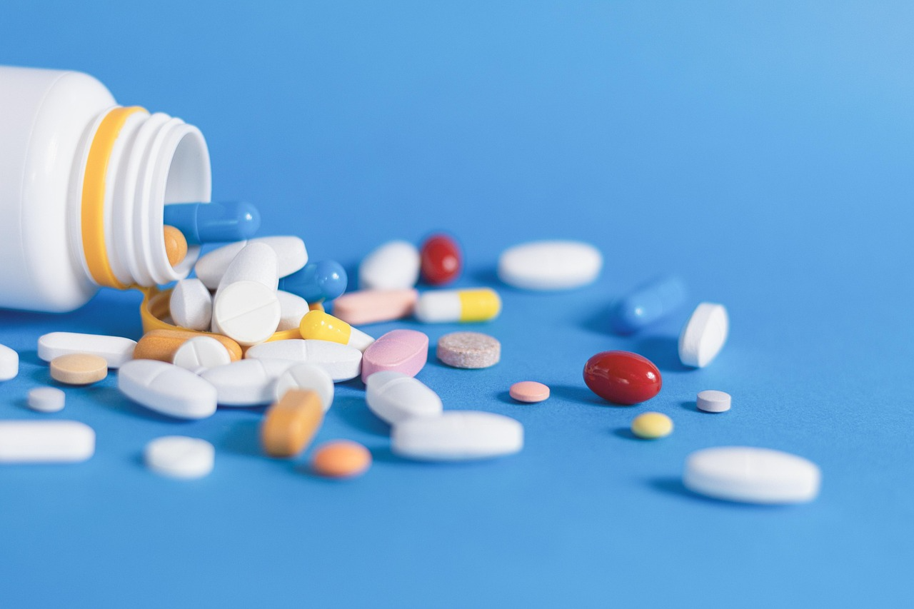
For those who don’t usually buy OTC medicines online, preference to speak with a pharmacist is the top reason chosen.
(Does not usually buy over-the-counter medicines online- 936)
Q6. You indicated in your response to the previous question that you do not usually buy over-the-counter medicines online. Which of the following best explains why?

Slide 21
Additionally, almost 1 in 5 (18%) report a mistrust for buying medicines online.
 |  | GENDER |  | AGE |  |  |  |  |  | REGION |  |  |  | PUBLIC PAYMENT SCHEME
 | TOTAL | Male | Female | 18-24 | 25-34 | 35-44 | 45-54 | 55-64 | 65+ | Dublin | Leinster (excl. Dublin) | Munster | Conn/ Ulster | Medical card | GMS | DRS | LTI
N= | 936 | 451 | 483 | 106 | 141 | 189 | 170 | 140 | 188 | 266 | 249 | 255 | 166 | 397 | 226 | 277 | 138
I prefer to speak with a pharmacist in person | 43% | 44% | 42% | 35% | 35% | 35% | 45% | 50% | 54% | 40% | 41% | 44% | 49% | 47% | 43% | 42% | 52%
I do not trust online sources for medicines | 18% | 19% | 17% | 18% | 14% | 15% | 16% | 18% | 27% | 19% | 19% | 19% | 12% | 18% | 17% | 20% | 12%
I am unsure which websites are safe or legitimate | 14% | 14% | 15% | 20% | 16% | 19% | 13% | 13% | 8% | 16% | 19% | 11% | 9% | 13% | 14% | 14% | 11%
Delivery takes too long or is inconvenient | 14% | 13% | 15% | 15% | 20% | 17% | 14% | 11% | 7% | 13% | 14% | 13% | 15% | 11% | 14% | 15% | 12%
I did not know it was possible to buy them online | 9% | 9% | 10% | 11% | 14% | 13% | 9% | 8% | 2% | 10% | 7% | 10% | 10% | 8% | 10% | 8% | 11%
Other | 2% | 1% | 3% | 2% | 1% | 2% | 3% | 1% | 2% | 1% | *% | 2% | 4% | 2% | 2% | 2% | 2%
Q6. You indicated in your response to the previous question that you do not usually buy over-the-counter medicines online. Which of the following best explains why?

Slide 22
61% are likely to buy a lower cost, generic version of an OTC medicine instead of a branded product if it was available.
(BASE : All respondents -1000)
 | GENDER |  | AGE |  |  |  |  |  | REGION |  |  |  | PUBLIC PAYMENT SCHEME
 | Male | Female | 18-24 | 25-34 | 35-44 | 45-54 | 55-64 | 65+ | Dublin | Leinster (excl. Dublin) | Munster | Conn/ Ulster | Medical card | GMS | DRS | LTI
N= | 493 | 506 | 112 | 160 | 202 | 181 | 148 | 197 | 289 | 268 | 268 | 175 | 425 | 246 | 303 | 149
Very likely | 21% | 35% | 16% | 23% | 28% | 29% | 35% | 32% | 27% | 28% | 27% | 29% | 24% | 27% | 32% | 27%
Likely | 36% | 30% | 27% | 30% | 31% | 33% | 35% | 41% | 36% | 29% | 36% | 29% | 34% | 30% | 27% | 32%
Neutral | 26% | 21% | 25% | 28% | 28% | 24% | 18% | 17% | 23% | 25% | 20% | 26% | 24% | 26% | 25% | 20%
Unlikely | 12% | 9% | 27% | 13% | 9% | 10% | 7% | 4% | 9% | 13% | 10% | 10% | 12% | 11% | 10% | 12%
Very unlikely | 5% | 5% | 5% | 6% | 5% | 4% | 6% | 6% | 5% | 4% | 6% | 6% | 6% | 6% | 6% | 9%
Summary
Likely | 57% | 65% | 43% | 53% | 59% | 62% | 69% | 73% | 63% | 58% | 63% | 59% | 58% | 57% | 59% | 59%
Unlikely | 18% | 14% | 32% | 19% | 14% | 14% | 13% | 9% | 14% | 17% | 16% | 16% | 18% | 17% | 16% | 21%
Very likely
Likely
61%
Likely
Neutral
Unlikely
Unlikely
16%
Very unlikely
Q7. If a lower-cost generic version of an over-the-counter medicine was available, how likely would you be to choose it instead of the branded product?

Slide 23
While 79% would find it helpful being informed of a better value version of an OTC medicine by their pharmacist.
(BASE : All respondents -1000)
 | GENDER |  | AGE |  |  |  |  |  | REGION |  |  |  | PUBLIC PAYMENT SCHEME
 | Male | Female | 18-24 | 25-34 | 35-44 | 45-54 | 55-64 | 65+ | Dublin | Leinster (excl. Dublin) | Munster | Conn/ Ulster | Medical card | GMS | DRS | LTI
N= | 493 | 506 | 112 | 160 | 202 | 181 | 148 | 197 | 289 | 268 | 268 | 175 | 425 | 246 | 303 | 149
Extremely helpful | 33% | 41% | 21% | 28% | 36% | 44% | 47% | 41% | 34% | 43% | 36% | 35% | 36% | 36% | 42% | 37%
Very helpful | 44% | 41% | 46% | 38% | 38% | 42% | 43% | 47% | 43% | 35% | 49% | 41% | 43% | 40% | 40% | 42%
Neutral | 13% | 9% | 17% | 23% | 12% | 7% | 3% | 7% | 14% | 13% | 7% | 10% | 11% | 14% | 8% | 10%
Moderately helpful | 9% | 9% | 14% | 12% | 13% | 7% | 7% | 4% | 8% | 9% | 8% | 12% | 9% | 9% | 9% | 10%
Not at all helpful | 1% | *% | 3% | 0% | 1% | 1% | 0% | 1% | *% | *% | 1% | 2% | 1% | 1% | 1% | 1%
Summary
Helpful | 77% | 82% | 67% | 66% | 74% | 86% | 90% | 88% | 77% | 78% | 84% | 77% | 78% | 76% | 82% | 79%
Unhelpful | 10% | 9% | 16% | 12% | 14% | 7% | 7% | 5% | 9% | 10% | 8% | 14% | 10% | 10% | 9% | 11%
Extremely helpful
Helpful
79%
Very helpful
Unhelpful
10%
Neutral
Moderately helpful
Not at all helpful
Q8. Would you find it helpful if your pharmacist told you when a better-value version of an over-the-counter medicine was available?

Slide 24
Over one-third (36%) report that cost has been a barrier to buying an OTC medicine in the past.
(BASE : All respondents -1000)
 | GENDER |  | AGE |  |  |  |  |  | REGION |  |  |  | PUBLIC PAYMENT SCHEME
 | Male | Female | 18-24 | 25-34 | 35-44 | 45-54 | 55-64 | 65+ | Dublin | Leinster (excl. Dublin) | Munster | Conn/ Ulster | Medical card | GMS | DRS | LTI
N= | 493 | 506 | 112 | 160 | 202 | 181 | 148 | 197 | 289 | 268 | 268 | 175 | 425 | 246 | 303 | 149
Yes | 30% | 42% | 40% | 43% | 38% | 34% | 40% | 24% | 34% | 38% | 35% | 36% | 42% | 41% | 36% | 43%
No | 64% | 52% | 52% | 49% | 58% | 61% | 52% | 70% | 60% | 56% | 59% | 58% | 53% | 54% | 59% | 52%
Not Sure | 6% | 7% | 8% | 7% | 4% | 6% | 9% | 6% | 6% | 6% | 7% | 7% | 5% | 5% | 6% | 4%
Q9. Has the cost of over-the-counter medicines ever stopped you from buying something you needed?

Slide 25
64% confirm that the cost of living has affected how they buy OTC medicines.
(BASE : All respondents -1000)
 | GENDER |  | AGE |  |  |  |  |  | REGION |  |  |  | PUBLIC PAYMENT SCHEME
 | Male | Female | 18-24 | 25-34 | 35-44 | 45-54 | 55-64 | 65+ | Dublin | Leinster (excl. Dublin) | Munster | Conn/ Ulster | Medical card | GMS | DRS | LTI
N= | 493 | 506 | 112 | 160 | 202 | 181 | 148 | 197 | 289 | 268 | 268 | 175 | 425 | 246 | 303 | 149
Yes – I buy them less often | 22% | 31% | 30% | 31% | 27% | 23% | 33% | 19% | 23% | 33% | 27% | 22% | 29% | 31% | 28% | 37%
Yes – I look for cheaper options | 38% | 42% | 44% | 46% | 44% | 43% | 39% | 29% | 38% | 41% | 39% | 47% | 38% | 39% | 41% | 36%
No – I buy them as I always have | 41% | 26% | 25% | 24% | 29% | 33% | 31% | 53% | 38% | 29% | 34% | 32% | 34% | 32% | 33% | 32%
Not sure / Prefer not to say | 3% | 4% | 7% | 4% | 2% | 2% | 2% | 3% | 3% | 1% | 5% | 3% | 2% | 2% | 1% | 1%
Summary
Yes | 56% | 71% | 68% | 72% | 69% | 65% | 67% | 44% | 59% | 70% | 61% | 65% | 64% | 66% | 66% | 67%
Yes
64%
Q10a. Has the cost of living affected how you buy over-the-counter medicines?

Slide 26
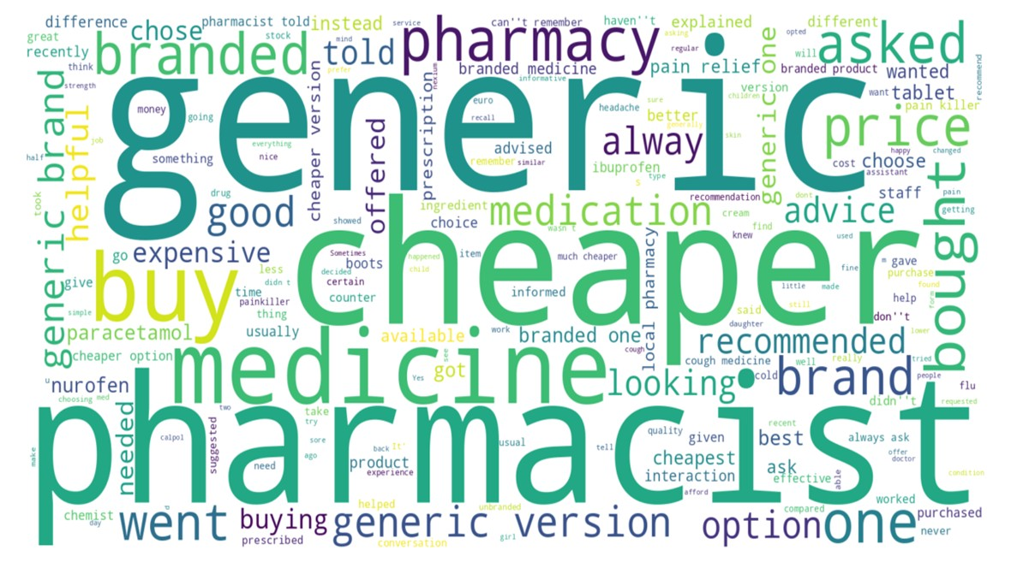
Cost, Trust, and Choice are the main factors that shapes medicine decisions
(BASE : All respondents -1000)
Q10b. Please describe a recent interaction you had in an Irish pharmacy when choosing between branded and generic medicines.

Slide 27





info@amarach.com
01 410 5200
www.amarach.com
amarach.research
@AmarachResearch

